Slide 1

Donate Eyes…
Why should we donate eyes?
"The eye is the window to the world, at the same time, it is the window of the soul." - Shakespeare.
Donate Eyes to Give Light

Slide 2
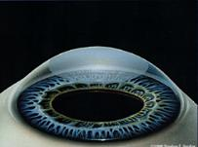
There is no artificial substitute to replace a human cornea (Eyes)
In India, the number of curable blind people exceeds more than 5 millions
More than 30,000 new victims are added each year to the total list
Much of the blindness in our country is treatable, or preventable.

Slide 3
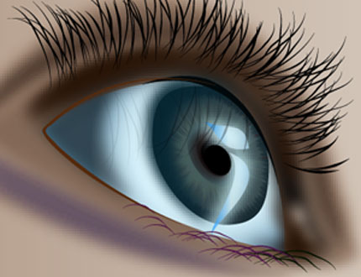
Eye donation is one of the
noblest of all causes.
If we have got God's gift of Vision;
if our Eyes can live even after death; why not try to pass it on to somebody who doesn't have it after our death?
To give sight to the blind pledge your eyes first.
http://www.ebai.org/html/eyepledgeform.asp
Inform your dear ones about your wish.

Slide 4

Who can donate eyes?
Practically anybody can donate from the age of 1 year.
Even if the deceased has medical history of hypertension, diabetes, asthma, tuberculosis etc can donate.
Spectacle wearers and people who have undergone cataract operation can donate eyes.

Slide 5

Procedure to donate eyes.
After death and should be collected within 6 hours.
Eyes will be collected at the donors place.
Collection of eyes will take only 10- 15 minutes.
A trained physician using sterile procedure removes the eyes.
To ensure no disfigurement of the face, artificial eyes are fitted in place.
10 cc of blood is collected for testing.

Slide 6

Key instructions
Close the eyelids of the deceased.
Place a polythene cover with few ice cubes on forehead.
Wrap some ice cubes in damp cotton and keep them on the eyes. This prevents the tissue from drying and helps keep it fresh.

Slide 7

Switch off the fan.
Raise the head of the deceased slightly by placing a pillow underneath.
Apply antibiotic eye drops to prevent infection.
Inform the nearest eye bank, dial 1919 (BSNL) or refer the site
http://www.ebai.org/html/eyepledgeform.asp

Slide 8

‘Letter of Appreciation’
Eye donation can be done only with the written consent of the next of kin in the presence of 2 witnesses.
After the donation, the donor’s family will receive a ‘Letter of Appreciation’ from the eye bank.

Slide 9

Who cannot donate eyes?
Persons infected with or died from AIDS, Hepatitis B or C, rabies, septicemia, acute leukemia, tetanus, cholera, meningitis or encephalitis cannot donate eyes.

Slide 10

What can you do?
Decide to donate your and your family’s eyes.
Donate eyes of your near and dear departed ones.
Create awareness of cornea retrieval.
Contribute your mite for cornea retrieval project.

Slide 11

One pair of eyes gives vision to
TWO corneal blind people.
Don’t take your eyes to heaven, God knows we need them here.

Slide 12

“Death is not the
last sleep,
it is the final
awakening.”

